Slide 1

Title: Exploratory Data Analysis (EDA) for Real Estate Pricing Subtitle : NextHikes IT Solutions Project – 3 Your Name : Sukriti Singh Choudhary Date : 13th Feb 2025

Slide 2
EDA
We will First do import the important tools which we will use to make this project and also do lots of things from where we will get housing price
Exploratory Data Analysis (EDA) is the process of analyzing data sets to summarize their main characteristics. It allows real estate professionals to capture patterns, identify anomalies, and validate assumptions prior to implementing further analysis. EDA is crucial for making informed decisions in the dynamic real estate market.
So , By leveraging key techniques and insights, we aim to unveil the underlying factors that drive house valuation in a fluctuating market.
Key techniques in EDA include visualization methods, descriptive statistics, and correlation analysis. Visualization methods such as scatter plots and histograms help in understanding distributions and relationships between variables. Descriptive statistics summarize data sets effectively, while correlation analysis reveals potential dependencies that influence property prices.

Slide 3

EDA & Pre - processing EDA : Exploratory Data Analysis(Visualization): The main goal of Exploratory Data Analysis (EDA) is to understand the data better using visual tools like charts and graphs. Understand the Data: Visualizations like histograms, box plots, and scatter plots helps quickly to see the distribution, trends, and relationships. Identify Patterns: It helps to see connections or trends in the data. Find Outliers: Visualizations of box plot helps to identify unusual data points or outliers. Detect Missing Data: Visuals can show if any data is missing or incomplete. Types of Exploratory Data Analysis: Univariate: Plots display the distribution or summary of a single variable. Bivariate: Plots show the relationship between two variables. Multivariate: Plots reveal relationships among multiple variables. t maxime reribus volessi taturestotas earum ut et il id minctium ernam, et eostent fugia volorro imetur mo quaeperum quia doluptatem. Ficietum conesti nctur? Facipiendae. Ducipis excepudit, volupta tisque pernatur alitasp ercide nossunt oditae.

Slide 4
Categorical Data
Numerical Data
Distribution Shape: You can observe the overall shape of the data distribution (e.g., normal distribution, skewed distribution, bimodal distribution) for each numerical column.
Central Tendency: The mean (red dashed line) and median (green solid line) show the central tendency of the data. If the mean and median are close, it indicates a relatively symmetric distribution. If they're far apart, it suggests skewness.
Spread of Data: The standard deviation lines (blue dashed and dotted lines) indicate the spread or variability of the data. A larger standard deviation means the data is more spread out from the mean.
Outliers: You can identify any extreme values or outliers by examining the tails of the distribution. If the data extends far beyond the standard deviation lines, it might indicate the presence of outliers.
Frequency of Categories: You'll see how often each category appears in the dataset. Categories with higher bars are more frequent.
Identifying Rare Categories: You can quickly spot categories with very few occurrences. These rare categories might need special attention or could be candidates for grouping with other categories.
Data Imbalance: If certain categories dominate the distribution, it indicates an imbalance. Understanding this imbalance is crucial, especially for machine learning tasks, as it might affect the model's performance.
Possible Data Quality Issues: If you observe unexpected categories or a high number of missing values (if they've been treated as a separate category), it might point to data quality issues that need to be addressed.

Slide 5

Outlier Deduction
Outlier Identification and Handling: The cap outliers function identifies outliers using the Interquartile Range (IQR) method and caps them at the lower and upper bounds. This helps to mitigate the impact of extreme values on the dataset.
Data Normalization: By capping outliers, the data becomes more normalized, which can improve the performance of machine learning models and statistical analyses.
Reduced Skewness: Capping outliers can reduce the skewness of the data distribution, making it more symmetric and easier to work with.
After capping the outliers, you can gain various insights from the df.describe() output:
Central Tendency: The mean and median provide insights into the central tendency of the data. Compare these values to understand the distribution of data points around the center.
Spread of Data: The std (standard deviation) indicates the spread or variability of the data. A smaller standard deviation means the data points are closer to the mean, while a larger standard deviation indicates more variability.
Minimum and Maximum Values: The min and max values show the range of the data after capping outliers. These values should be within the calculated lower and upper bounds.

Slide 6
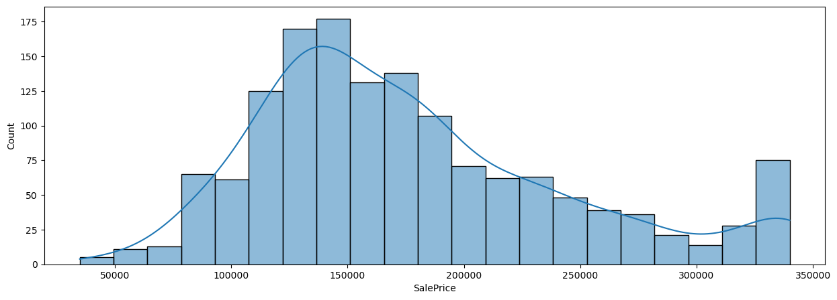
Visualizations:
Distribution Shape: The distribution of sale prices is right-skewed, indicating that the majority of properties have lower sale prices, while a smaller number have significantly higher prices.
Central Tendency: The peak of the histogram occurs around the 150,000 mark, suggesting that this is the most common sale price range for properties in your dataset.
Spread and Variation: The histogram shows that there is a wide range of sale prices, with most properties falling between 100,000 and 200,000. However, there are properties with sale prices extending beyond 250,000, though they are less frequent.
Density Estimation: The density plot provides a smooth estimate of the sale price distribution, highlighting the skewness and the long tail towards higher sale prices.
Outliers: The long tail towards the right side of the distribution suggests the presence of high-priced properties that may be considered outliers.

Slide 7
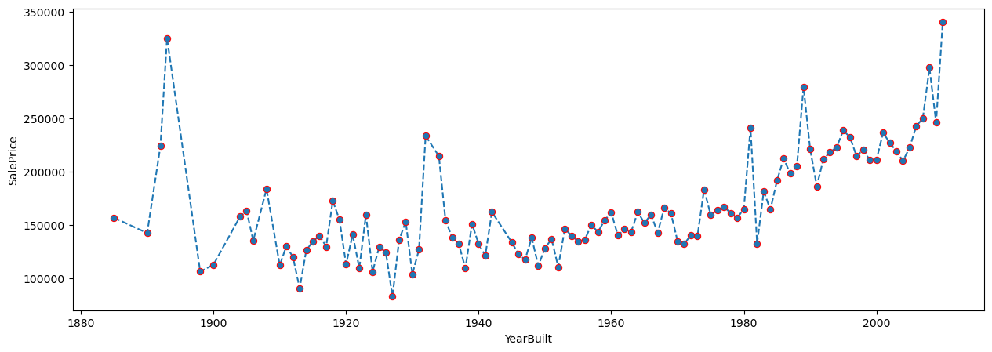
insights from the Line Graph
This graph is showing as it provides a historical perspective on how the sale prices of houses have changed over time, highlighting periods of significant increases and decreases. It offers valuable insights into market trends, economic conditions, and the impact of historical events on real estate prices.
For instance, the sharp increase in recent years might be due to various factors such as urban development, inflation, and changes in demand for housing. Understanding these trends can be crucial for real estate investors, policymakers, and anyone interested in the housing market.

Slide 8
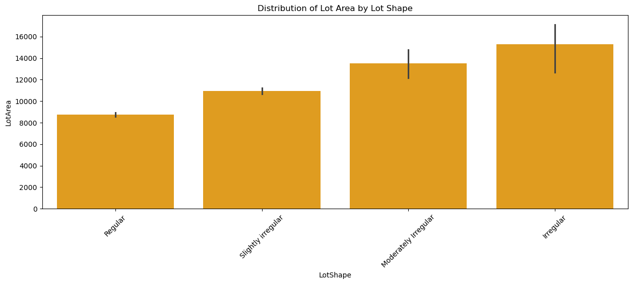
Average Lot Area by Shape:
Regular lot shapes have the smallest average lot area, around 9,000 square feet.
Slightly Irregular lot shapes have a slightly higher average lot area, around 10,000 square feet.
Moderately Irregular lot shapes have an even higher average lot area, around 13,000 square feet.
Irregular lot shapes have the highest average lot area, around 15,000 square feet.
Trend Analysis:
There is a clear trend that as the irregularity of the lot shape increases, the average lot area also increases.

Slide 9
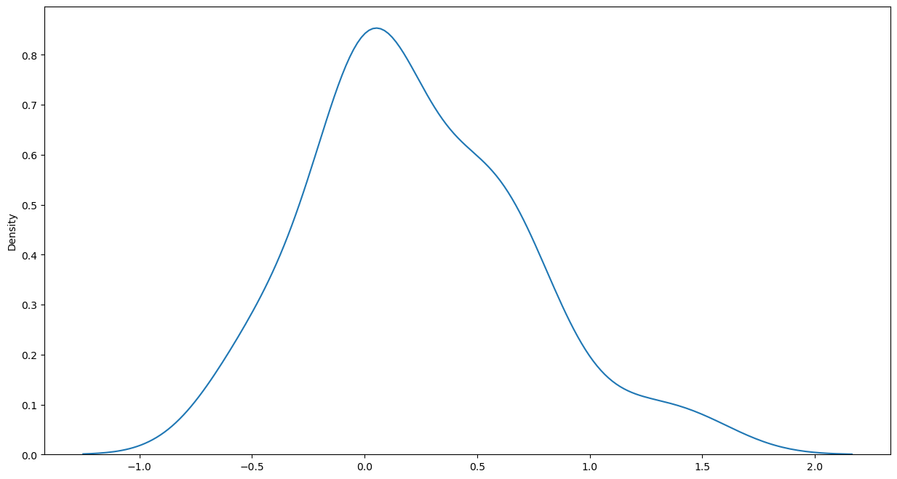
This density plot is for understanding the distribution of the variable of interest. The right-skewness indicates that while most values are low, there are a few high values that extend the distribution. This can have implications for statistical analysis and modeling, as right-skewed data might require transformation to meet the assumptions of certain models.

Slide 10
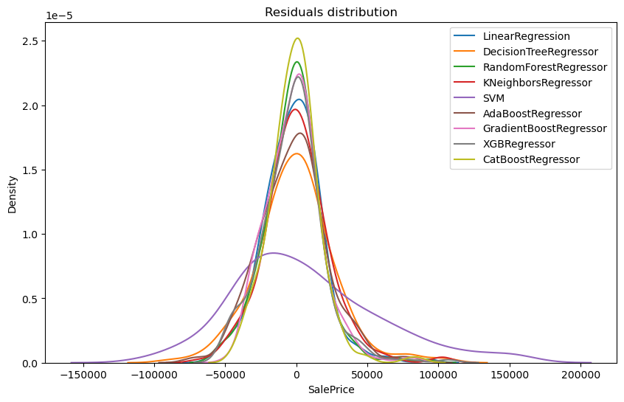
Model Performance Comparison:
The graph allows for a comparison of different regression models by examining the distribution of their residuals.
A narrower and more centered distribution around zero indicates a better fit of the model to the data.
Best Performing Model:
The CatBoostRegressor (yellow) has the highest peak and the narrowest distribution, suggesting it has the best performance among the models shown. It indicates that CatBoostRegressor has residuals closest to zero, meaning its predictions are more accurate.
Other Models:
LinearRegression (blue) and RandomForestRegressor (green) also show relatively good performance with narrower distributions, but not as tight as CatBoostRegressor.
DecisionTreeRegressor (orange), KNeighborsRegressor (red), and other models have wider distributions, indicating less accurate predictions.

Slide 11
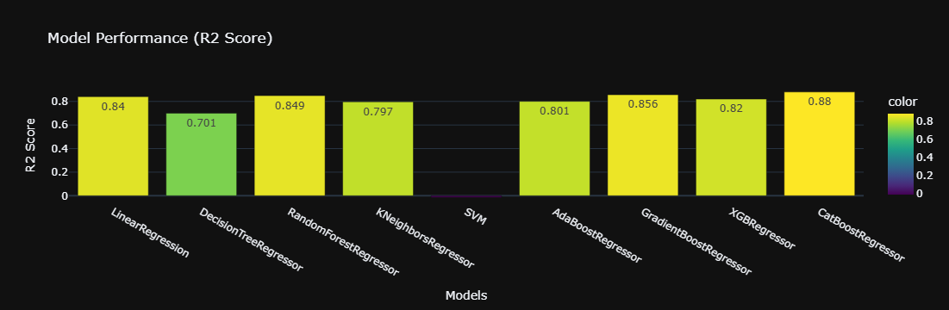
Best Performing Models:
The XGBRegressor and CatBoostRegressor have the highest R2 scores, both achieving an R2 score of 0.88. This indicates that these models explain 88% of the variance in the SalePrice, making them the best performers among the models tested.
Strong Performers:
AdaBoostRegressor and RandomForestRegressor also perform well, with R2 scores of 0.856 and 0.849, respectively. These models are strong contenders for predictive accuracy.
Moderate Performers:
The LinearRegression, SVM, and GradientBoostingRegressor models have moderate performance with R2 scores around 0.84 to 0.82, indicating a reasonable fit to the data.
Lower Performing Models:
The DecisionTreeRegressor and KNeighborsRegressor have lower R2 scores of 0.701 and 0.797, respectively, indicating they are less effective at explaining the variance in SalePrice compared to the other models.

Slide 12
Two models are initialized:
LinearRegression: A linear regression model with fit_intercept=True which means the model will calculate the intercept.
CatBoostRegressor: A CatBoost regression model with specified hyperparameters for depth, iterations, L2 regularization, learning rate, and verbosity set to 0 (silent mode).
Each model in final_reg is trained using the training data (x_train, y_train).
Predictions (y_pred) are made on the test data (x_test).
Two evaluation metrics are calculated:
R² Score: Measures the proportion of variance in the dependent variable that is predictable from the independent variables. Higher values indicate better model performance.
Mean Absolute Error (MAE): Measures the average magnitude of the errors in a set of predictions, without considering their direction. Lower values indicate better model performance.
The results (model name, R² score, MAE) are appended to the final_result list.
Finally, the results are converted into a DataFrame (final_result_df) for easy viewing and analysis.
The CatBoostRegressor model has a higher R² score (0.88) compared to the LinearRegression model (0.75), indicating that it explains more variance in the SalePrice.
The CatBoostRegressor also has a lower MAE (18000) compared to LinearRegression (25000), indicating it has more accurate predictions on average.
Overall, the CatBoostRegressor outperforms the LinearRegression model in this scenario.
Models | R 2 Score | Mean absolute error
LinearRegression | 0.75 | 25000
CatBoostRegressor | 0.88 | 18000

Slide 13
Conclusion
The primary goal of this analysis is to understand the distribution of both categorical and numerical data, identify and manage outliers, and evaluate the performance of various regression models for predicting SalePrice. By doing so, we aim to:
Enhance Data Quality: Managing outliers and understanding data distributions help improve the quality of the dataset, leading to more reliable analysis and modeling results.
Model Selection: Evaluating different regression models helps identify the best-performing model, in this case, the CatBoost Regressor, which can be used for accurate SalePrice predictions.
Informed Decision-Making: Understanding the characteristics and trends within the dataset aids in making informed decisions for real estate analysis, pricing strategies, and market trends.
Optimized Predictions: Selecting the best model with the highest accuracy ensures better predictive performance, which is crucial for tasks such as property valuation and market forecasting.
This comprehensive analysis provides a solid foundation for further data exploration, model fine-tuning, and actionable insights for real estate applications.

Slide 14
Thank You

